Slide 1
Residual Neuromuscular Blockade and Postoperative Pulmonary
Complications: What Does the Recent Evidence Demonstrate?
Guy Cammu, MD PhD
Anesthesiology, Critical Care and Emergency Medicine,
Onze-Lieve-Vrouw Ziekenhuis, Moorselbaan 164,
9300 Aalst, Belgium
guy.cammu@olvz-aalst.be

Slide 2

With the support of
This live webcast has been realized thanks to the support of MSD. The views expressed in this presentation reflect the experience and opinions of the speakers and not necessarily that of MSD. Please note that this presentation may contain information about experimental uses of drugs that are currently not approved by regulatory agencies. Meeting attendees are encouraged to consult the prescribing information for the drugs mentioned in this presentation (via www.afmps.be or https://www.fagg.be/nl).
BE-XBR-00098 Date of last revision 08/2020

Slide 4
Conflicts of Interest
GC is a principal consultant for MSD and received research grants and lecture fees over the years and performed funded research on sugammadex
GC is a member of Senzime Scientific Advisory Board.

Slide 5
Etiology of PPCs
Multiple factors, including surgical, anesthetic and patient variables, contribute to the etiology of PPCs
Surgical risk factors: emergency surgery, long duration of surgery and type of surgery
Anesthetic causes: opioids, NMBAs and general anesthesia
Patient risk factors: chronic obstructive pulmonary disease, diabetes, obesity, advanced age

Slide 6
Residual NMB and PPCs:
The Evidence from the Past

Slide 7
Mechanisms of PPCs
Residual effects of intraoperatively administered NMBAs → impairment of muscular activity in the postoperative period → development of PPCs
Impaired contraction of ventilatory muscles with atelectasis formation
Inability to cough
Impaired swallowing, with accumulation of airway secretions and aspiration of gastric contents

Slide 8
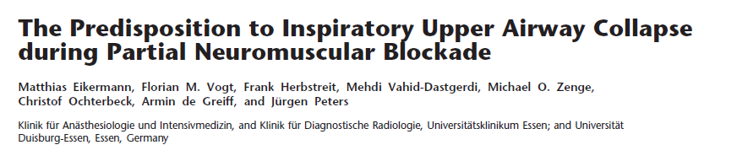
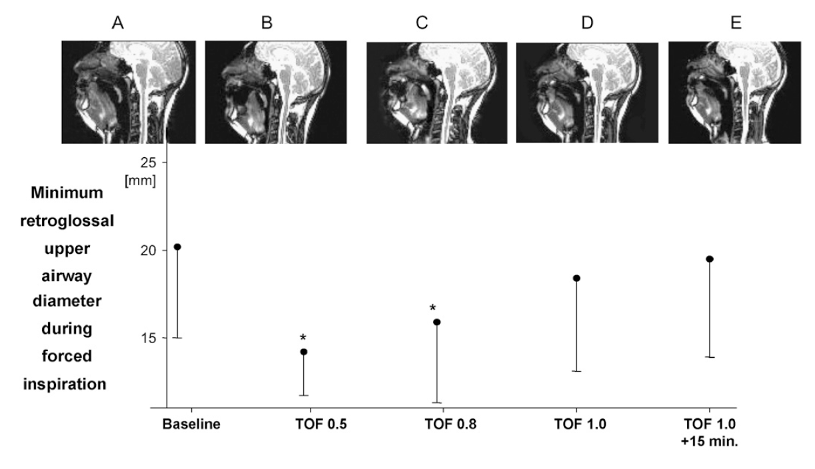


Am J Respir Crit Care Med Vol 175. pp 9–15, 2007

Slide 9
Effect of the reversal of residual block on PPCs: less frequent if neostigmine had been used
NMBA but not a reversal agent: 2.3 times more PPCs than those who received neostigmine
  Bulka CM, et al. Nondepolarizing neuromuscular blocking agents, reversal, and risk of postoperative pneumonia. Anesthesiology 2016;125:647–655.
Not administering neostigmine was associated with a 70% increase in PPCs
  Bronsert MR, et al. Intermediateacting nondepolarizing neuromuscular blocking agents and risk of postoperative 30-day morbidity and mortality, and long-term survival. Anesth Analg 2017;124:1476–1483.

Slide 11
Residual NMB and PPCs:
The Conflicting Evidence

Slide 12
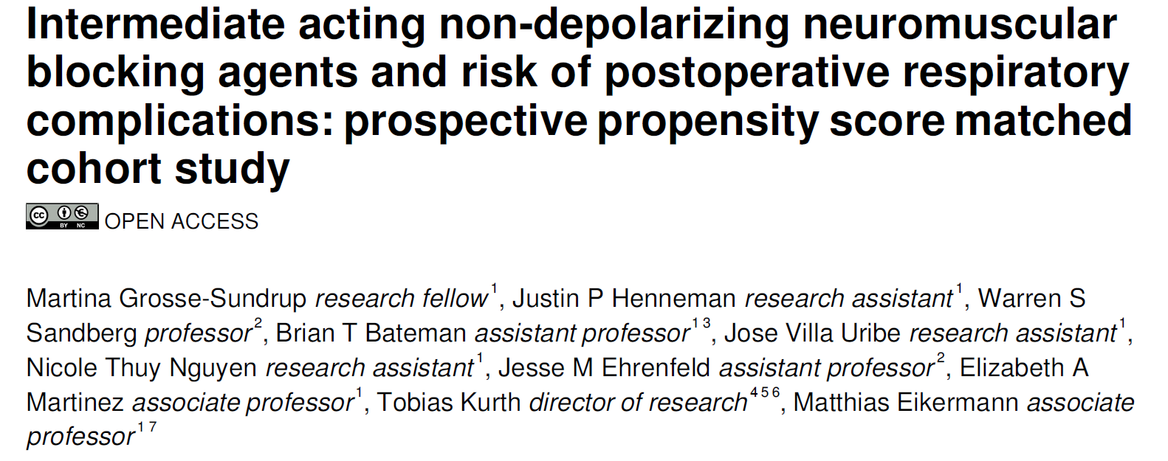
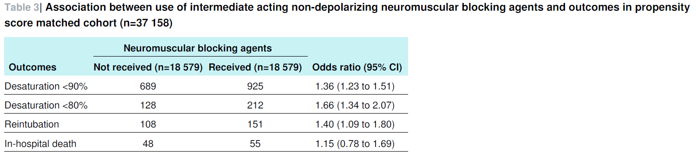
BMJ 2012; 345: e6329

Slide 13
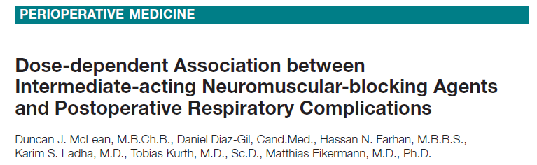
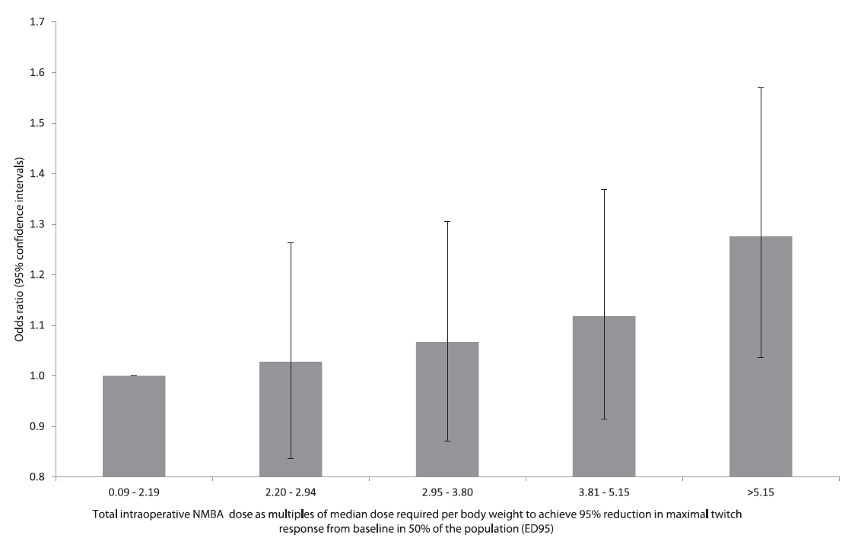
50.000 subjects

Slide 14
Neuromuscular monitoring and reversal agents seem not to reduce the risk for PPCs

Slide 15
POPULAR study - ESA
17,150 patients received an NMBA
In more than 10,000 of these patients, NMT monitoring was not applied: extubation of their tracheas was based solely on clinical criteria
One-third of the patients who received objective NMT monitoring were extubated with a TOFR<0.9
= INADEQUATELY MANAGED NMB

Slide 16
Complicated overview of the inappropriate practice of NMB management in our institution
Neuromuscular transmission monitoring results, reversal data and incidence of postoperative residual curarization in six subgroups of patients.
 | No NMT monitoring - no reversal (n=112) | No NMT monitoring - reversal with neostigmine (n=33) | NMT monitoring - no reversal (n=181) | NMT monitoring - reversal with neostigmine (n=181) | NMT monitoring – reversal with sugammadex (n=75) | NMT monitoring - reversal with neostigmine and sugammadex (n=5)
TOFR* | 0.98 (0.33-1.00) | 0.98 (0.80-1.00) | 0.98 (0.28-1.00) | 0.97 (0.64-1.00) | 0.98 (0.72-1.00) | 1.00 (0.83-1.00)
TOFR between 0.7 and 0.9 | 13/112 (12%) | 5/33 (15%) | 20/181 (11%) | 22/181 (12%) | 8/75 (11%) | 1/5 (20%)
TOFR below 0.7 | 5/112 (4%) | 0 | 4/181 (2%) | 3/181 (2%) | 0 | 0
Data are median (ranges) or relative number (%).
*P = 0.24.
Cammu et al, AIC 2020

Slide 17
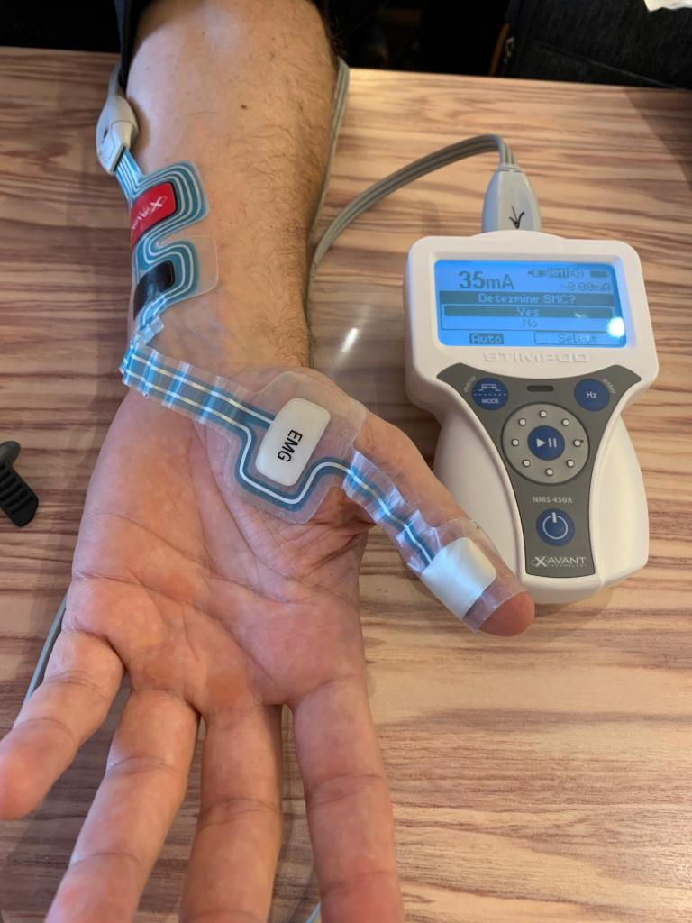
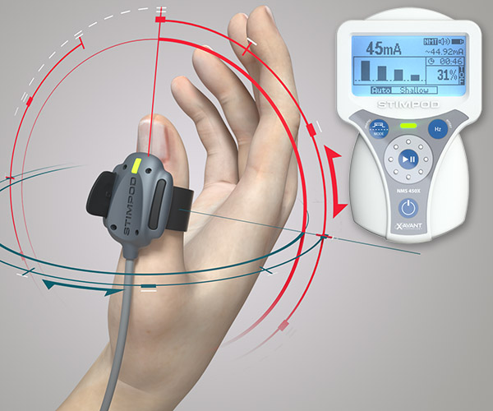
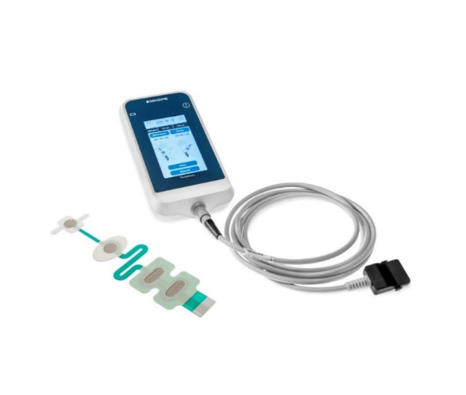
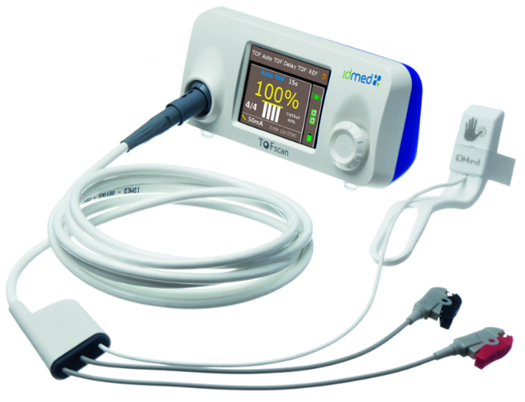
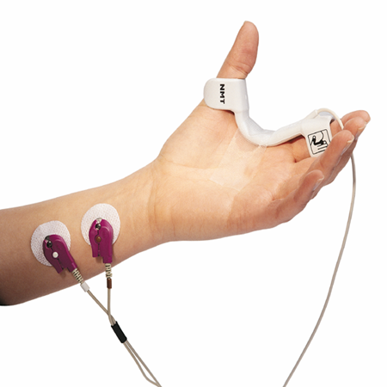
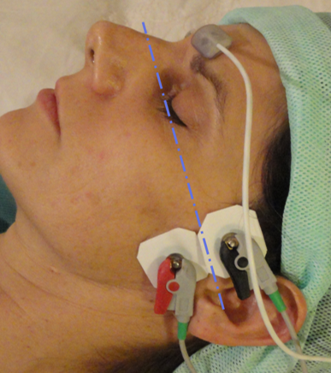
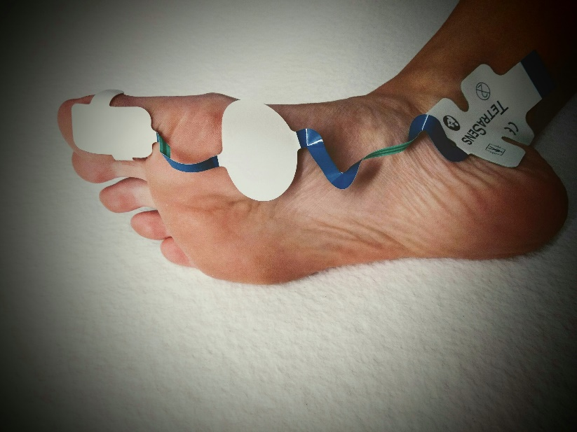
Monitoring techniques: acceleromyography – electromyography –kinemyography
Muscle monitoring site: peripheral adductor pollicis – posterior tibial nerve / central corrugator supercilii

Slide 18


2020: Improvements in interpretation of NMT monitoring are still required

Slide 19
Residual NMB and PPCs:
The Recent Evidence

Slide 20
Effects of High Neuromuscular Blocking Agent Dose on Postoperative Respiratory Complications in Infants and Children
Flora T. Scheffenbichler et al,
AAS 2020;64:156-167.
6507 non-cardiac surgical procedures in children aged 0 to 10 years
High intraoperative NMBA dose = significantly associated with an increased risk of PPCs within 3 days of surgery.

Slide 21
Recommended threshold for neuromuscular recovery needs revision ?

Slide 22
At last…
22,856 patients receiving sugammadex were matched to 22,856 patients receiving neostigmine
Sugammadex (compared to neostigmine) was associated with:
30% reduced risk of pulmonary complications
47% reduced risk of pneumonia
55% reduced risk of respiratory failure

Slide 23
* More efficient reversal of NMB with less residual paralysis
* Full recovery in diaphragm function
Schepens T, Cammu G, Saldien V, et al. Eur J Anaesthesiol 2015;32:49-57

Slide 24
Quantitative NMT monitoring and the correct interpretation of it preclude residual NMB and may, through that mechanism, decrease the incidence of PPCs
Causes of PPCs are multifactorial
Recent data suggest that PPCs are reduced for a TOFR > 0.95 before tracheal extubation
Sugammadex may reduce postoperative respiratory morbidity.

Slide 25
Abbreviations
PPC Post-operative Pulmonary Complications
NMBA Neuromuscular Blocking Agent
NMB Neuromuscular Blocker
TOF Train of Four
ICU Intensive Care Unit
ESA European Society of Anesthesiology
NMT Neuromuscular Transmission
TOFr Train of Four ratio
POPC Post-operative Pulmonary Complications

Slide 26
1. NAME OF THE MEDICINAL PRODUCT Bridion 100 mg/mL solution for injection 2. QUALITATIVE AND QUANTITATIVE COMPOSITION 1 mL contains sugammadex sodium equivalent to 100 mg sugammadex. Each vial of 2 mL contains sugammadex sodium equivalent to 200 mg sugammadex. Each vial of 5 mL contains sugammadex sodium equivalent to 500 mg sugammadex. Excipient(s) with known effect Contains up to 9.7 mg/mL sodium (see section 4.4). For the full list of excipients, see section 6.1. 3. PHARMACEUTICAL form Solution for injection (injection). Clear and colourless to slightly yellow solution. The pH is between 7 and 8 and osmolality is between 300 and 500 mOsm/kg. 4. Clinical particulars 4.1 Therapeutic indications Reversal of neuromuscular blockade induced by rocuronium or vecuronium in adults. For the paediatric population: sugammadex is only recommended for routine reversal of rocuronium induced blockade in children and adolescents aged 2 to 17 years. 4.2 Posology and method of administration Posology Sugammadex should only be administered by, or under the supervision of an anaesthetist. The use of an appropriate neuromuscular monitoring technique is recommended to monitor the recovery of neuromuscular blockade (see section 4.4). The recommended dose of sugammadex depends on the level of neuromuscular blockade to be reversed. The recommended dose does not depend on the anaesthetic regimen. Sugammadex can be used to reverse different levels of rocuronium or vecuronium induced neuromuscular blockade: Adults Routine reversal: A dose of 4 mg/kg sugammadex is recommended if recovery has reached at least 1‑2 post-tetanic counts (PTC) following rocuronium or vecuronium induced blockade. Median time to recovery of the T₄/T₁ ratio to 0.9 is around 3 minutes (see section 5.1). A dose of 2 mg/kg sugammadex is recommended, if spontaneous recovery has occurred up to at least the reappearance of T₂ following rocuronium or vecuronium induced blockade. Median time to recovery of the T₄/T₁ ratio to 0.9 is around 2 minutes (see section 5.1). Using the recommended doses for routine reversal will result in a slightly faster median time to recovery of the T₄/T₁ ratio to 0.9 of rocuronium when compared to vecuronium induced neuromuscular blockade (see section 5.1). Immediate reversal of rocuronium-induced blockade: If there is a clinical need for immediate reversal following administration of rocuronium a dose of 16 mg/kg sugammadex is recommended. When 16 mg/kg sugammadex is administered 3 minutes after a bolus dose of 1.2 mg/kg rocuronium bromide, a median time to recovery of the T₄/T₁ ratio to 0.9 of approximately 1.5 minutes can be expected (see section 5.1). There is no data to recommend the use of sugammadex for immediate reversal following vecuronium induced blockade. Re‑administration of sugammadex: In the exceptional situation of recurrence of neuromuscular blockade post-operatively (see section 4.4) after an initial dose of 2 mg/kg or 4 mg/kg sugammadex, a repeat dose of 4 mg/kg sugammadex is recommended. Following a second dose of sugammadex, the patient should be closely monitored to ascertain sustained return of neuromuscular function. Re-administration of rocuronium or vecuronium after sugammadex: For waiting times for re-administration of rocuronium or vecuronium after reversal with sugammadex, see section 4.4. Additional information on special population Renal impairment: The use of sugammadex in patients with severe renal impairment (including patients requiring dialysis (CrCl < 30 mL/min)) is not recommended (see section 4.4). Studies in patients with severe renal impairment do not provide sufficient safety information to support the use of sugammadex in these patients (see also section 5.1). For mild and moderate renal impairment (creatinine clearance ≥ 30 and < 80 mL/min): the dose recommendations are the same as for adults without renal impairment. Elderly patients: After administration of sugammadex at reappearance of T₂ following a rocuronium induced blockade, the median time to recovery of the T₄/T₁ ratio to 0.9 in adults (18‑64 years) was 2.2 minutes, in elderly adults (65‑74 years) it was 2.6 minutes and in very elderly adults (75 years or more) it was 3.6 minutes. Even though the recovery times in elderly tend to be slower, the same dose recommendation as for adults should be followed (see section 4.4). Obese patients: In obese patients, including morbidly obese patients (body mass index ≥ 40 kg/m²), the dose of sugammadex should be based on actual body weight. The same dose recommendations as for adults should be followed. Hepatic impairment: Studies in patients with hepatic impairment have not been conducted. Caution should be exercised when considering the use of sugammadex in patients with severe hepatic impairment or when hepatic impairment is accompanied by coagulopathy (see section 4.4). For mild to moderate hepatic impairment: as sugammadex is mainly excreted renally no dose adjustments are required. Paediatric population The data for the paediatric population are limited (one study only for reversal of rocuronium induced blockade at reappearance of T₂). Children and adolescents: For routine reversal of rocuronium induced blockade at reappearance of T₂ in children and adolescents (2‑17 years) 2 mg/kg sugammadex is recommended. Bridion 100 mg/mL may be diluted to 10 mg/mL to increase the accuracy of dosing in the paediatric population (see section 6.6). Other routine reversal situations have not been investigated and are therefore not recommended until further data become available. Immediate reversal in children and adolescents has not been investigated and is therefore not recommended until further data become available. Term newborn infants and infants: There is only limited experience with the use of sugammadex in infants (30 days to 2 years), and term newborn infants (less than 30 days) have not been studied. The use of sugammadex in term newborn infants and infants is therefore not recommended until further data become available. Method of administration Sugammadex should be administered intravenously as a single bolus injection. The bolus injection should be given rapidly, within 10 seconds, into an existing intravenous line (see section 6.6). Sugammadex has only been administered as a single bolus injection in clinical trials. 4.3 Contraindications Hypersensitivity to the active substance or to any of the excipients listed in section 6.1. 4.8 Undesirable effects Summary of the safety profile Bridion is administered concomitantly with neuromuscular blocking agents and anaesthetics in surgical patients. The causality of adverse events is therefore difficult to assess. The most commonly reported adverse reactions in surgical patients were cough, airway complication of anaesthesia, anaesthetic complications, procedural hypotension and procedural complication (Common (≥ 1/100 to < 1/10)). Table 2: Tabulated list of adverse reactions The safety of sugammadex has been evaluated in 3,519 unique subjects across a pooled phase I‑III safety database. The following adverse reactions were reported in placebo controlled trials where subjects received anaesthesia and/or neuromuscular blocking agents (1,078 subject exposures to sugammadex versus 544 to placebo): [Very common (≥ 1/10), common (≥ 1/100 to < 1/10), uncommon (≥ 1/1,000 to < 1/100), rare (≥ 1/10,000 to < 1/1,000), very rare (< 1/10,000)] . System organ class/Frequencies/ Adverse reactions (Preferred terms): Immune system disorders Uncommon: Drug hypersensitivity reactions (see section 4.4). Respiratory, thoracic and mediastinal disorders Common: Cough. Injury, poisoning and procedural complications Common: Airway complication of anaesthesia, Anaesthetic complication (see section 4.4), Procedural hypotension, Procedural complication. Description of selected adverse reactions Drug hypersensitivity reactions: Hypersensitivity reactions, including anaphylaxis, have occurred in some patients and volunteers (for information on volunteers, see Information on healthy volunteers below). In clinical trials of surgical patients these reactions were reported uncommonly and for post-marketing reports the frequency is unknown. These reactions varied from isolated skin reactions to serious systemic reactions (i.e. anaphylaxis, anaphylactic shock) and have occurred in patients with no prior exposure to sugammadex. Symptoms associated with these reactions can include: flushing, urticaria, erythematous rash, (severe) hypotension, tachycardia, swelling of tongue, swelling of pharynx, bronchospasm and pulmonary obstructive events.

Slide 27
Severe hypersensitivity reactions can be fatal. Airway complication of anaesthesia: Airway complications of anaesthesia included bucking against the endotracheal tube, coughing, mild bucking, arousal reaction during surgery, coughing during the anaesthetic procedure or during surgery, or anaesthetic procedure‑related spontaneous breath of patient. Anaesthetic complication: Anaesthetic complications, indicative of the restoration of neuromuscular function, include movement of a limb or the body or coughing during the anaesthetic procedure or during surgery, grimacing, or suckling on the endotracheal tube. See section 4.4 light anaesthesia. Procedural complication: Procedural complications included coughing, tachycardia, bradycardia, movement, and increase in heart rate. Marked bradycardia: In post-marketing, isolated cases of marked bradycardia and bradycardia with cardiac arrest have been observed within minutes after administration of sugammadex (see section 4.4). Recurrence of neuromuscular blockade: In clinical studies with subjects treated with rocuronium or vecuronium, where sugammadex was administered using a dose labelled for the depth of neuromuscular blockade (N=2,022), an incidence of 0.20% was observed for recurrence of neuromuscular blockade as based on neuromuscular monitoring or clinical evidence (see section 4.4). Information on healthy volunteers: A randomised, double‑blind study examined the incidence of drug hypersensitivity reactions in healthy volunteers given up to 3 doses of placebo (N=76), sugammadex 4 mg/kg (N=151) or sugammadex 16 mg/kg (N=148). Reports of suspected hypersensitivity were adjudicated by a blinded committee. The incidence of adjudicated hypersensitivity was 1.3%, 6.6% and 9.5% in the placebo, sugammadex 4 mg/kg and sugammadex 16 mg/kg groups, respectively. There were no reports of anaphylaxis after placebo or sugammadex 4 mg/kg. There was a single case of adjudicated anaphylaxis after the first dose of sugammadex 16 mg/kg (incidence 0.7%). There was no evidence of increased frequency or severity of hypersensitivity with repeat dosing of sugammadex. In a previous study of similar design, there were three adjudicated cases of anaphylaxis, all after sugammadex 16 mg/kg (incidence 2.0%). In the Pooled Phase 1 database, AEs considered common (≥ 1/100 to < 1/10) or very common (≥ 1/10) and more frequent among subjects treated with sugammadex than in the placebo group, include dysgeusia (10.1%), headache (6.7%), nausea (5.6%), urticaria (1.7%), pruritus (1.7%), dizziness (1.6%), vomiting (1.2%) and abdominal pain (1.0%). Additional information on special populations Pulmonary patients: In post-marketing data and in one dedicated clinical trial in patients with a history of pulmonary complications, bronchospasm was reported as a possibly related adverse event. As with all patients with a history of pulmonary complications the physician should be aware of the possible occurrence of bronchospasm. Paediatric population A limited database suggests that the safety profile of sugammadex (up to 4 mg/kg) in paediatric patients was similar to that in adults. Morbidly obese patients In one dedicated clinical trial in morbidly obese patients, the adverse reaction profile was generally similar to the profile in adult patients in pooled Phase 1 to 3 studies (see Table 2). Reporting of suspected adverse reactions Reporting suspected adverse reactions after authorisation of the medicinal product is important. It allows continued monitoring of the benefit/risk balance of the medicinal product. Healthcare professionals are asked to report any suspected adverse reactions via n Belgium: Agence fédérale des médicaments et des produits de santé [Federal Agency for Medicines and Health Products]. Division Vigilance. Boîte Postale 97, B-1000 Bruxelles Madou. (Website: www.afmps.be, email: adversedrugreactions@fagg-afmps.be), in Luxembourg: Centre Régional de Pharmacovigilance de Nancy - Bâtiment de Biologie Moléculaire et de Biopathologie (BBB) - CHRU de Nancy – Hôpitaux de Brabois, Rue du Morvan 54, 511 VANDOEUVRE LES NANCY CEDEX, Tél : (+33) 3 83 65 60 85 / 87, Fax : (+33) 3 83 65 61 33, E-mail : crpv@chru-nancy.fr or Direction de la Santé – Division de la Pharmacie et des Médicaments [Directorate of Health - Division of Pharmacy and Medicines] Villa Louvigny – Allée Marconi. L-2120 Luxembourg. Tél. : (+352) 2478 5592, Fax : (+352) 2479 5615, email : pharmacovigilance@ms.etat.lu. Link to the formulary http://www.sante.public.lu/fr/politique-sante/ministere-sante/direction-sante/div-pharmacie-medicaments/index.html. 7. MARKETING AUTHORISATION HOLDER Merck Sharp & Dohme B.V., Waarderweg 39, 2031 BN Harlem, The Netherlands 8. MARKETING AUTHORISATION NUMBER(S) EU/1/08/466/001; EU/1/08/466/002. 9. DATE OF FIRST AUTHORISATION/RENEWAL OF THE AUTHORISATION Date of first authorisation: 25 July 2008. Date of latest renewal: 21 June 2013. 10. DATE OF REVISION OF THE TEXT 04/2020 Detailed information on this medicinal product is available on the website of the European Medicines Agency http://www.ema.europa.eu. DELIVERY on medical presciption.

