Slide 1

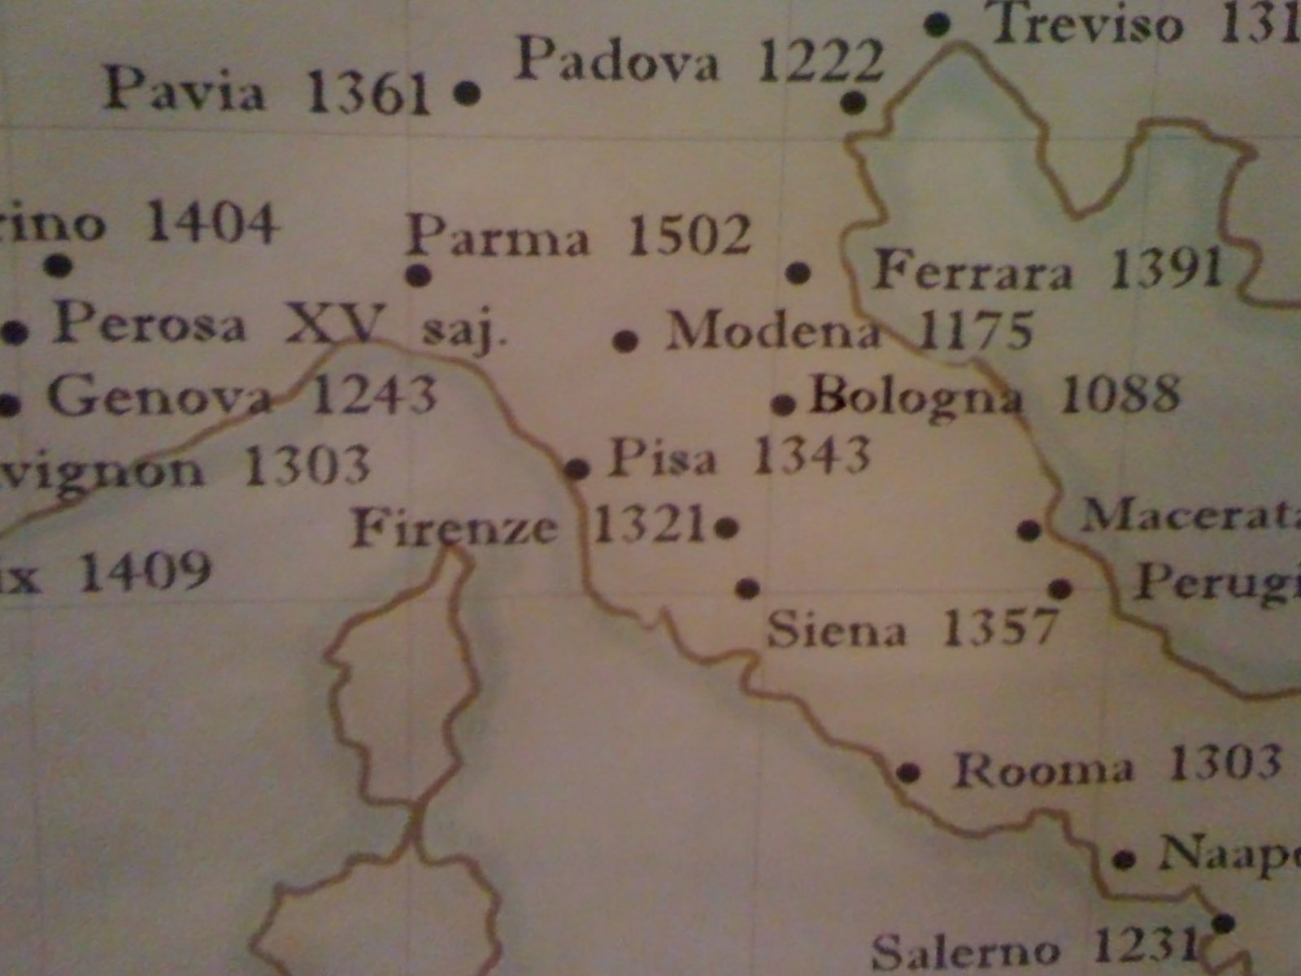

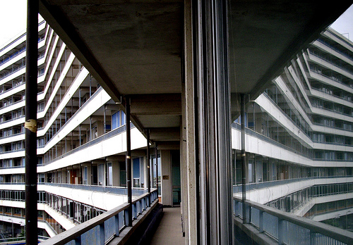
Post-Operative Pulmonary Complications (PPCs):
a significant problem
in clinical anesthesia
PAOLO PELOSI, MD, FERS
on behalf of PROVEnet
Department of Surgical Sciences and Integrated Diagnostics (DISC), San Martino Policlinico Hospital
IRCCS for Oncology and Neurosciences,
University of Genoa, Italy
ppelosi@hotmail.com
FOCUS ON POST‐OPERATIVE
PULMONARY COMPLICATIONS

Slide 2

Conflicts of Interest
I declare
NO conflicts of interest
Pelosi P for the PROVE Network (www.provenet.eu)

Slide 3

Conflicts of Interest
With the support of
This live webcast has been realized thanks to the support of MSD. The views expressed in this presentation reflect the experience and opinions of the speakers and not necessarily that of MSD. Please note that this presentation may contain information about experimental uses of drugs that are currently not approved by regulatory agencies. Meeting attendees are encouraged to consult the prescribing information for the drugs mentioned in this presentation (via www.afmps.be or https://www.fagg.be/nl).
BE-XBR-00114 Date of last revision 11/2020

Slide 4








PROtective VEntilation NETwork
To perform:
Multicenter observational studies
Randomized controlled trials
Meta-analysis
Health economy analysis
Translation and education
http://www.provenet.eu/
Pelosi P for the PROVE Network – www.provenet.eu

Slide 5
Agenda
Postoperative mortality
Atelectasis in the postoperative period
Postoperative pulmonary complications:
- definition
- incidence
- type of surgery
- timing
- mortality
- obesity
- night time
Predictive scores
Intraoperative complications
Intraoperative PEEP to prevent PPC
Strategies to prevent PPC
Conclusions
Pelosi P for the PROVE Network (www.provenet.eu)

Slide 6


EuSOS
European Surgical Outcomes Study
Lancet 2012; 380:1059-1065
46,539 patients - 498 hospitals – 28 european countries
In-Hospital Mortality is HIGH (3 – 4 % !!)
High Mortality in the Ward (10-15%)
Age, ASA (IV-V) & Cancer
Upper Abdominal, Vascular, Cardiac & Thoracic Surgery
Pelosi P for the PROVE Network (www.provenet.eu)

Slide 7
Agenda
Postoperative mortality
Atelectasis in the perioperative period
Postoperative pulmonary complications:
- definition
- incidence
- type of surgery
- timing
- mortality
- obesity
- night time
Predictive scores
Intraoperative complications
Intraoperative PEEP to prevent PPC
Strategies to prevent PPC
Conclusions
Pelosi P for the PROVE Network (www.provenet.eu)

Slide 8
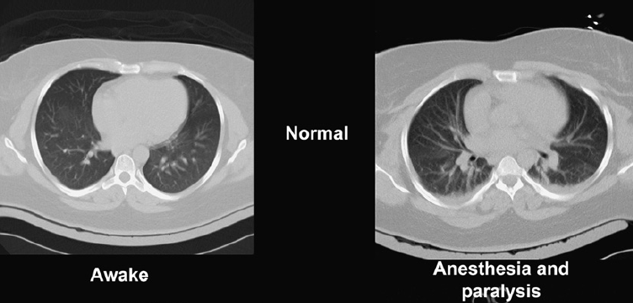
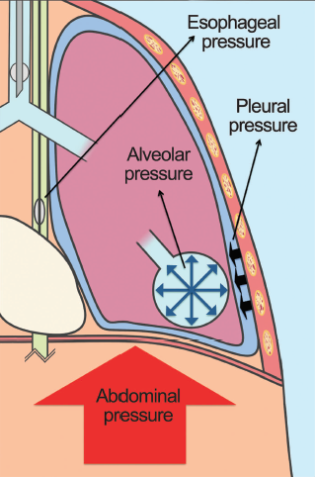
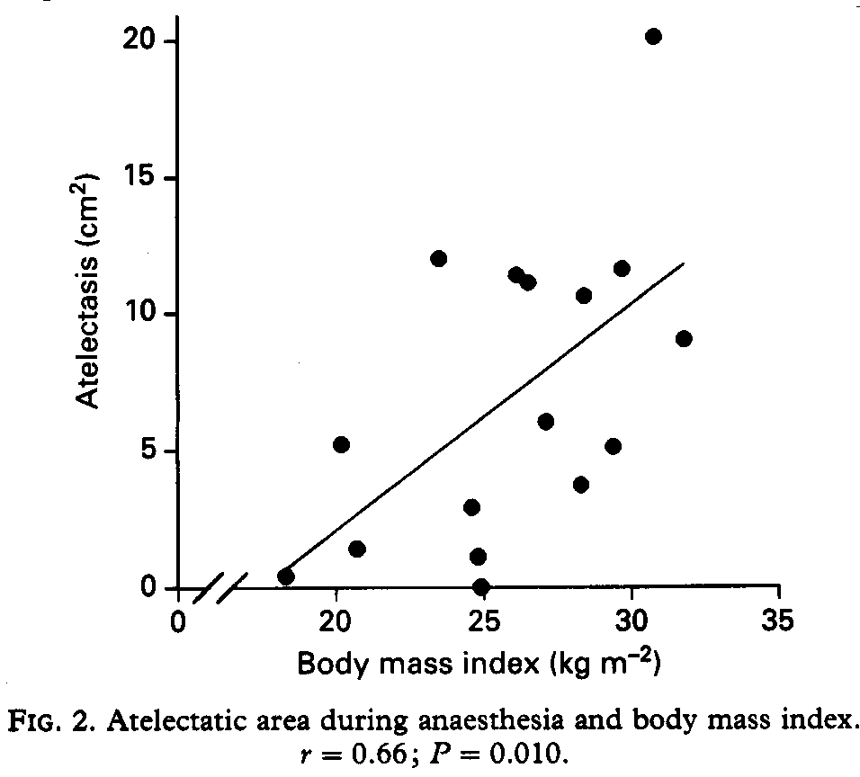
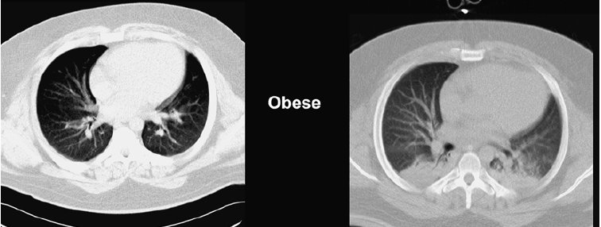
Effects of Anesthesia on Lung Morphology
Rothen HU et al. Br J Anaesth 1993, 71:788-95
Reinius H et al. Anesthesiology. 2009 Nov;111(5):979-87
Pelosi P et al. Best Pract Res Clin Anaesthesiol. 2010 Jun;24(2):211-25
Imber DAE et al. Respir Care. 2016 Dec;61(12):1681-1692
Non aerated tissue
0.5 (0.0-1)%
Non aerated tissue
3 (0.5-5)%
Non aerated tissue
1 (0.5-1)%
Non aerated tissue
11 (5-17)%
Pelosi P for the PROVE Network (www.provenet.eu)

Slide 9
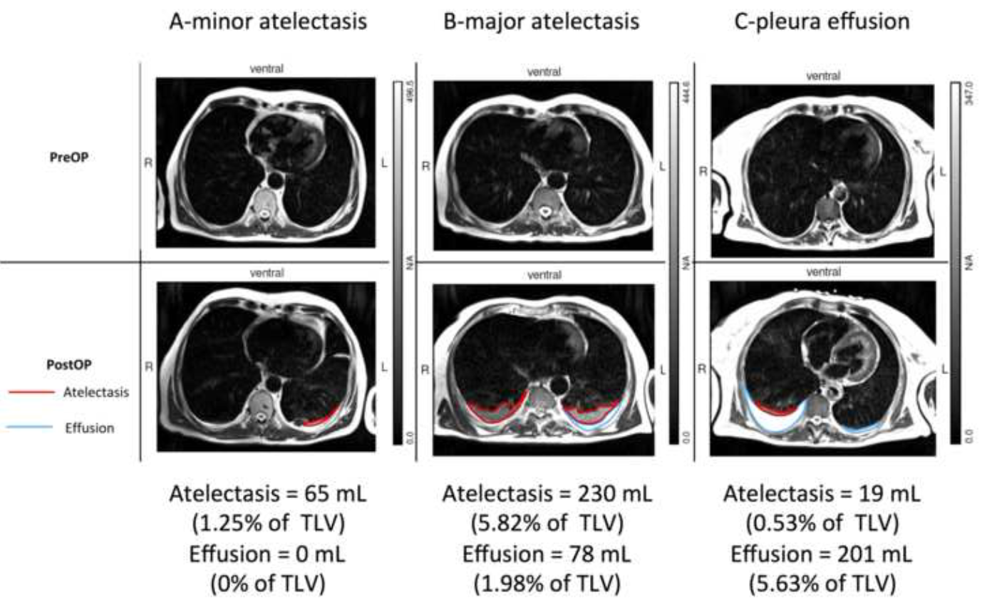
…but not only postoperative atelectasis
Güldner A. et al. Anesthesiology. 2015 Sep;123(3):692-713

Slide 10
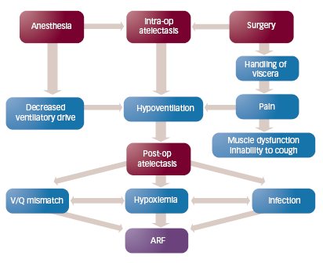

Intraoperative/postoperative Atelectasis and Postoperative Pulmonary Complications
Pelosi P, Gregoretti C Best Pract Res Clin Anaesthesiol. 2010 Jun;24(2):211-25.

Slide 11
Agenda
Postoperative mortality
Atelectasis in the perioperative period
Postoperative pulmonary complications:
- definition
- incidence
- type of surgery
- timing
- mortality
- obesity
- night time
Predictive scores
Intraoperative complications
Intraoperative PEEP to prevent PPC
Strategies to prevent PPC
Conclusions
Pelosi P for the PROVE Network (www.provenet.eu)

Slide 12

Definitions of PPCs
Griffiths SV et al.Perioper Med (Lond). 2018 Apr 17;7:7
Abbott TEF et al. Br J Anaesth. 2018 May;120(5):1066-1079
The LAS VEGAS Investigators. Eur J Anaesthesiol 2017; 34:492–507
Pelosi P for the PROVE Network (www.provenet.eu)

Slide 13
Agenda
Postoperative mortality
Atelectasis in the perioperative period
Postoperative pulmonary complications:
- definition
- incidence
- type of surgery
- timing
- mortality
- obesity
- night time
Predictive scores
Intraoperative complications
Intraoperative PEEP to prevent PPC
Strategies to prevent PPC
Conclusions
Pelosi P for the PROVE Network (www.provenet.eu)

Slide 14
Postoperative Pulmonary Complications are frequent
Canet J et al. Anesthesiology. 2010 Dec;113(6):1338-50
Mazo V et al. Anesthesiology. 2014 Aug;121(2):219-31
The LAS VEGAS Investigators - Eur J Anaesthesiol 2017; 34:492–507
Patients (n)
Prevalence (%)
ARISCAT
2464
6.2%
PERISCOPE
5859
7.9%
LAS VEGAS
9697
10.4%
Pelosi P for the PROVE Network – www.provenet.eu

Slide 15
Agenda
Postoperative mortality
Atelectasis in the perioperative period
Postoperative pulmonary complications:
- definition
- incidence
- type of surgery
- timing
- mortality
- obesity
- night time
Predictive scores
Intraoperative complications
Intraoperative PEEP to prevent PPC
Strategies to prevent PPC
Conclusions
Pelosi P for the PROVE Network (www.provenet.eu)

Slide 16
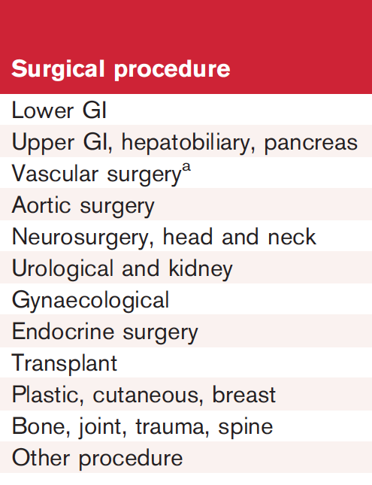
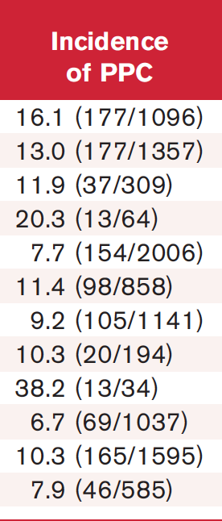
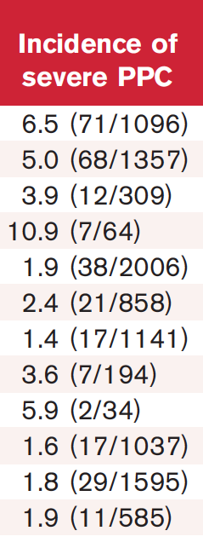
PPCs depend on type of surgery
The LAS VEGAS Investigators - Eur J Anaesthesiol 2017; 34:492–507
Pelosi P for the PROVE Network (www.provenet.eu)

Slide 17
Agenda
Postoperative mortality
Atelectasis in the perioperative period
Postoperative pulmonary complications:
- definition
- incidence
- type of surgery
- timing
- mortality
- obesity
- night time
Predictive scores
Intraoperative complications
Intraoperative PEEP to prevent PPC
Strategies to prevent PPC
Conclusions
Pelosi P for the PROVE Network (www.provenet.eu)

Slide 18
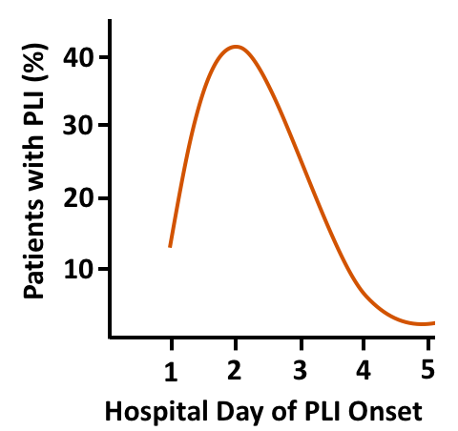
Postoperative Pulmonary Complications develop at the 2-3rd postoperative day
Serpa Neto A. et al. Lancet Respir Med. 2014 Dec; 2(12):1007-15.
The LAS VEGAS Investigators - Eur J Anaesthesiol 2017; 34:492–507
Pelosi P for the PROVE Network – www.provenet.eu

Slide 19
Agenda
Postoperative mortality
Atelectasis in the perioperative period
Postoperative pulmonary complications:
- definition
- incidence
- type of surgery
- timing
- mortality
- obesity
- night time
Predictive scores
Intraoperative complications
Intraoperative PEEP to prevent PPC
Strategies to prevent PPC
Conclusions
Pelosi P for the PROVE Network (www.provenet.eu)

Slide 20
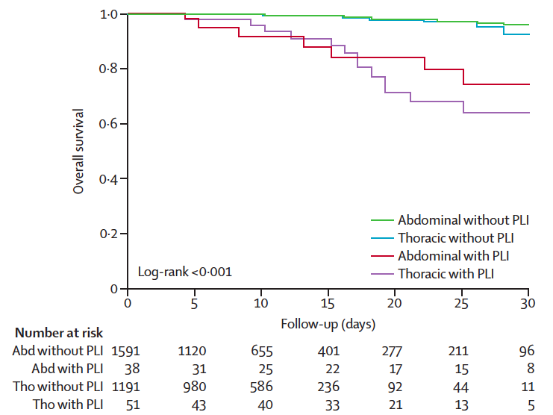
Postoperative Pulmonary Complications increase morbidity and mortality
Serpa Neto A. et al. Lancet Respir Med. 2014 Dec; 2(12):1007-15.
The LAS VEGAS Investigators - Eur J Anaesthesiol 2017; 34:492–507
Mortality
1.4%
25.2%
39.4%
LOS: 15 vs 30 days
Pelosi P for the PROVE Network – www.provenet.eu

Slide 21
Agenda
Postoperative mortality
Atelectasis in the perioperative period
Postoperative pulmonary complications:
- definition
- incidence
- type of surgery
- timing
- mortality
- obesity
- night time
Predictive scores
Intraoperative complications
Intraoperative PEEP to prevent PPC
Strategies to prevent PPC
Conclusions
Pelosi P for the PROVE Network (www.provenet.eu)

Slide 22
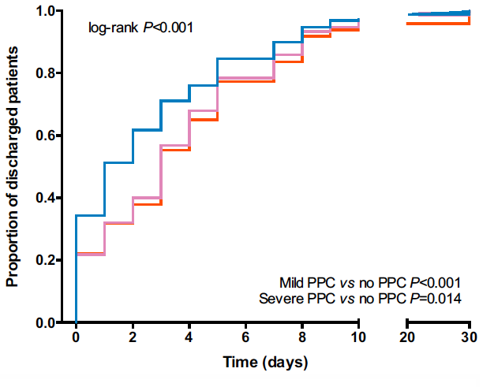
PPCs are more frequent when BMI > 40 Kg/m²
Ball L et al. Br J Anaesth. 2018 Oct;121(4):899-908
The LAS VEGAS Investigators - Eur J Anaesthesiol 2017; 34:492–507
Class I: 30.0 to 34.9 kg/m² - Class II; 35 to 39.9 kg/m² - Class III; ≥ 40 kg/m²
2012 obese and 7852 non obese pts/ 135 hosp
2012 patients from 135 hospitals
No PPC
ARF 6%
MV 2.4%
Mild PPC
ARF 1.4%
MV 0.9%
Severe PPC
ARF 0.9%
MV 0.6%
2012 patients from 135 hospitals
non obese pts
Pelosi P for the PROVE Network (www.provenet.eu)

Slide 23
Agenda
Postoperative mortality
Atelectasis in the perioperative period
Postoperative pulmonary complications:
- definition
- incidence
- type of surgery
- timing
- mortality
- obesity
- night time
Predictive scores
Intraoperative complications
Intraoperative PEEP to prevent PPC
Strategies to prevent PPC
Conclusions
Pelosi P for the PROVE Network (www.provenet.eu)

Slide 24
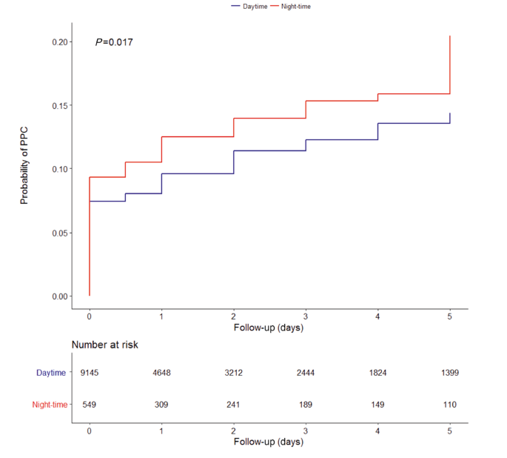
Intraop adverse events and PPCs occurred more often in pts undergoing night-time surgery
Cortegiani A et al. Br J Anaesth. 2019 Mar;122(3):361-369.
9861 patients, 555 (5.6%) underwent surgery during night-time
Daytime (9036)
Nightime (555)
P
Total intraoperative Aes (%)
34.1
43.6
0.001
Desaturations (%)
3.8
6.1
0.008
Hypotension (%)
26.2
33.3
0.001
Need of vasopressors (%)
21.9
31.8
0.001
LOS (days)
1 (0-4)
2 (0-5)
0.001
Death 28th (%)
0.6
1.5
0.001
Pelosi P for the PROVE Network (www.provenet.eu)

Slide 25
Agenda
Postoperative mortality
Atelectasis in the perioperative period
Postoperative pulmonary complications:
- definition
- incidence
- type of surgery
- timing
- mortality
- obesity
- night time
Predictive scores
Intraoperative complications
Intraoperative PEEP to prevent PPC
Strategies to prevent PPC
Conclusions
Pelosi P for the PROVE Network (www.provenet.eu)

Slide 26
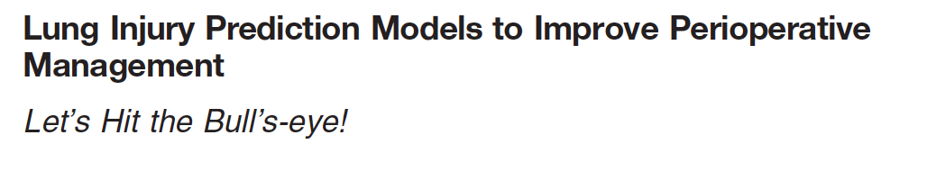

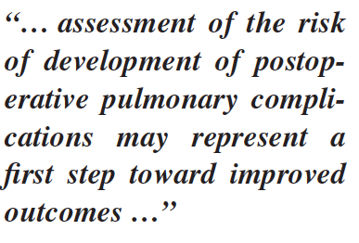
Pelosi P and Gama de Abreu M
Anesthesiology 2011: 115: 10-11
Pelosi P for the PROVE Network (www.provenet.eu)

Slide 27
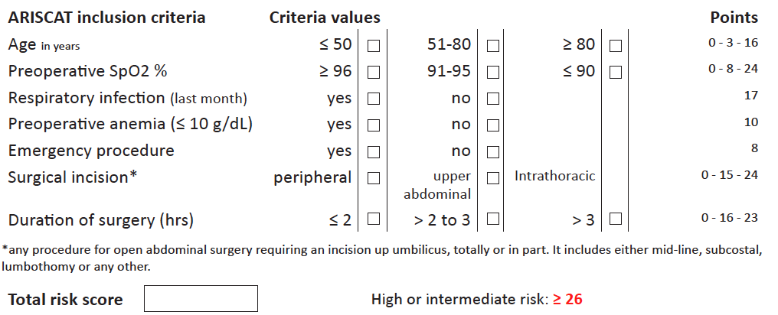
To Predict the Risk of PPCs: “ARISCAT” Score
Canet J. et al. for ARISCAT, Anesthesiology. 2010; 113(6):1338-50.
Mazo V. et al. Anesthesiology. 2014 Aug;121(2):219-31
13 % (score 26-44) – 54 % (score >45) risk to develop PPCs
11
Pelosi P for the PROVE Network (www.provenet.eu)

Slide 28
“ARISCAT” Score predicts PPCs and post-operative mortality in non cardiac surgery
The LAS VEGAS Investigators - Eur J Anaesthesiol 2017; 34:492–507
9864 patients enrolled in 146 centres
Pelosi P for the PROVE Network (www.provenet.eu)

Slide 29
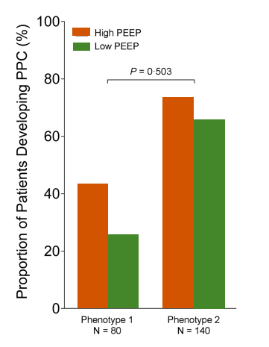
Distinct preoperative biological phenotypes predict PPCs in patients undergoing abdominal surgery
Serpa-Neto A et al. Eur J Anaesthesiol. 2018 Sep;35(9):702-709.
0.57
0.04
Pelosi P for the PROVE Network (www.provenet.eu)

Slide 30
Agenda
Postoperative mortality
Atelectasis in the perioperative period
Postoperative pulmonary complications:
- definition
- incidence
- type of surgery
- timing
- mortality
- obesity
- night time
Predictive scores
Intraoperative complications
Intraoperative PEEP to prevent PPC
Strategies to prevent PPC
Conclusions
Pelosi P for the PROVE Network (www.provenet.eu)

Slide 31
Intraoperative hemodynamic events are more frequent than respiratory events
Ball L et al. Br J Anaesth. 2018 Oct;121(4):899-908
Class I: 30.0 to 34.9 kg/m² - Class II; 35 to 39.9 kg/m² - Class III; ≥ 40 kg/m²
_{Non}
_{Obese}
PEEP 4 (0-5) cm H₂O
_{Class I}
_{Class II}
_{Class III}
₍₆₇₃₆₎
₍₁₃₁₅₎
₍₄₄₉₎
₍₂₄₈₎
_{Desaturation}
_{3.3%}
_{5.7%}
_{7.3%}
_{14.9%}
_{- Recruitment}
_{2.5%}
_{5.5%}
_{5.1%}
_{11.2%}
_{- Increased FiO2}
_{0.8%}
_{0.2%}
_{2.1%}
_{3.7%}
_{Hypotension}
_{23.7%}
_{24.9%}
_{27.2%}
_{27.4%}
_{- Vasoactive drugs}
_{18.5%}
_{23.2%}
_{23.4%}
_{27.0%}
_{- Fluids}
_{5.2%}
_{1.7%}
_{3.8%}
_{0.4%}
Pelosi P for the PROVE Network – www.provenet.eu

Slide 32
The “LAS VEGAS risk score”: intra+postop
Serpa-Neto A for PROVEnet Investigators Eur J Anaesthesiol 2018; 35:1–11
6062 patients enrolled in 146 centres
Pelosi P for the PROVE Network (www.provenet.eu)

Slide 33
Agenda
Postoperative mortality
Atelectasis in the perioperative period
Postoperative pulmonary complications:
- definition
- incidence
- type of surgery
- timing
- mortality
- obesity
- night time
Predictive scores
Intraoperative complications
Intraoperative PEEP to prevent PPC
Strategies to prevent PPC
Conclusions
Pelosi P for the PROVE Network (www.provenet.eu)

Slide 34
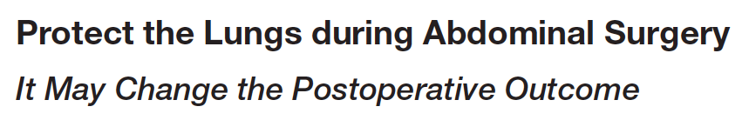
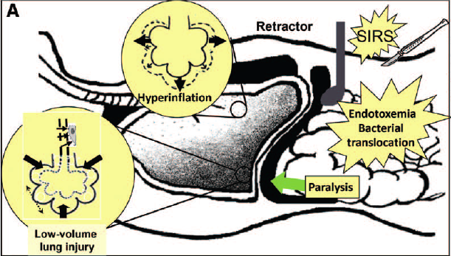
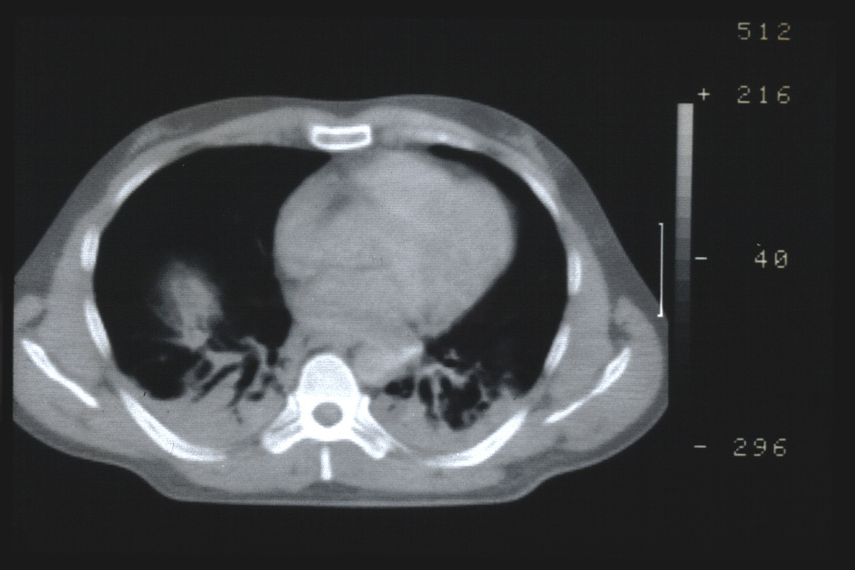
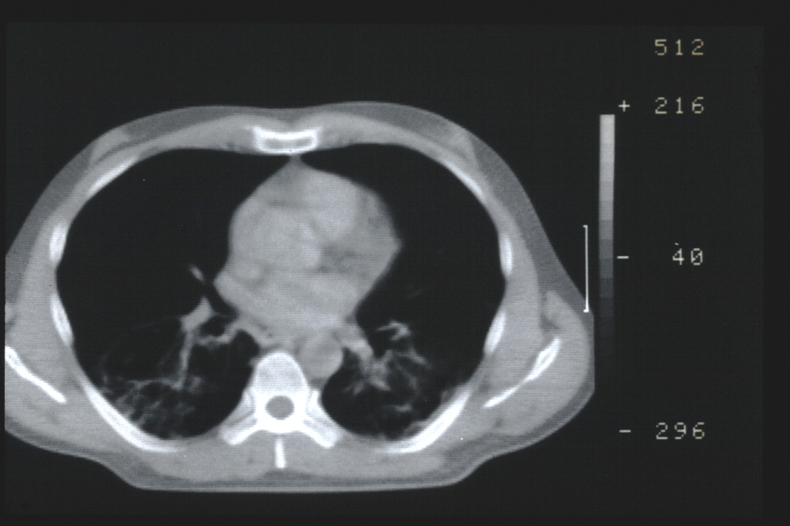
Vidal Melo M.F., Eikermann M. Anesthesiology 2013; 118:1254-7
Severgnini P. et al. Anesthesiology. 2013 Jun;118(6):1307-21
ZEEP
PEEP
Pelosi P for the PROVE Network (www.provenet.eu)
Notes:
34
34

Slide 35
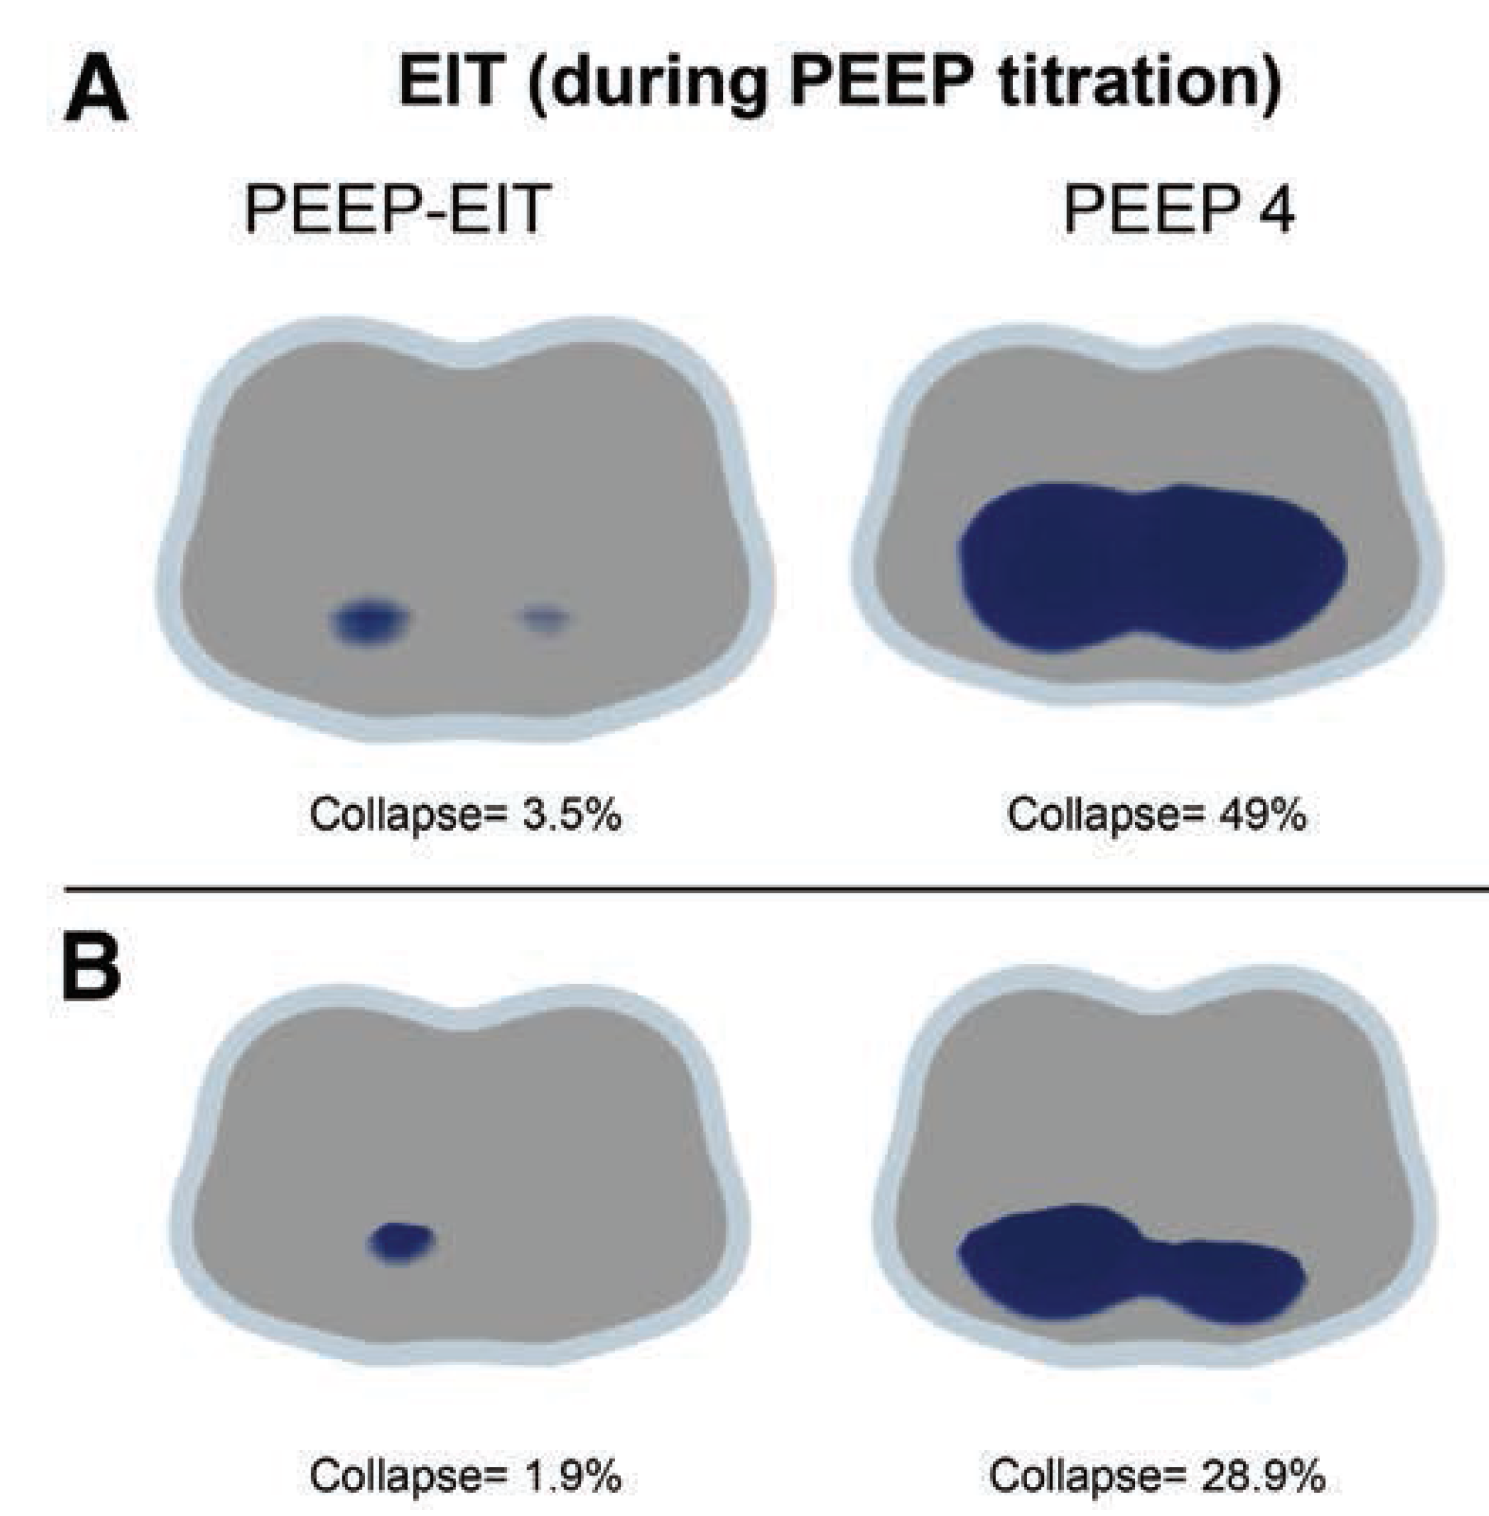
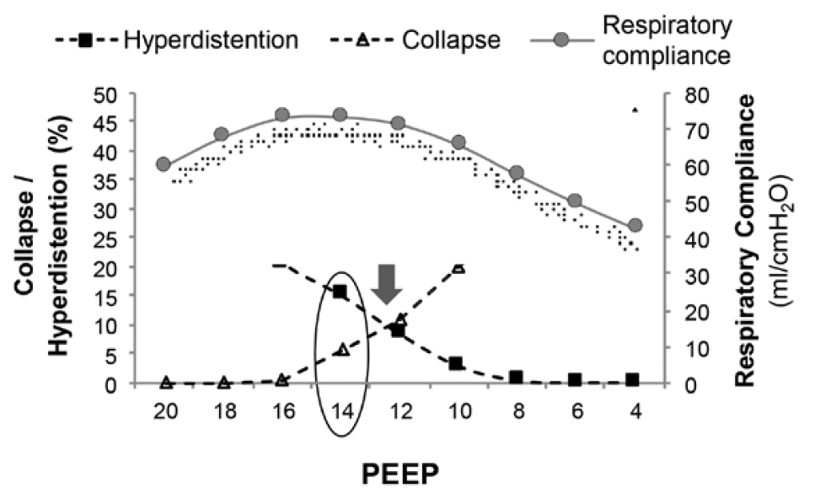
Individualized EIT-guided PEEP does not improve post-operative atelectasis
Pereira SM et al. Anesthesiology. 2018 Dec;129(6):1070-1081
Pelosi P for the PROVE Network (www.provenet.eu)

Slide 36
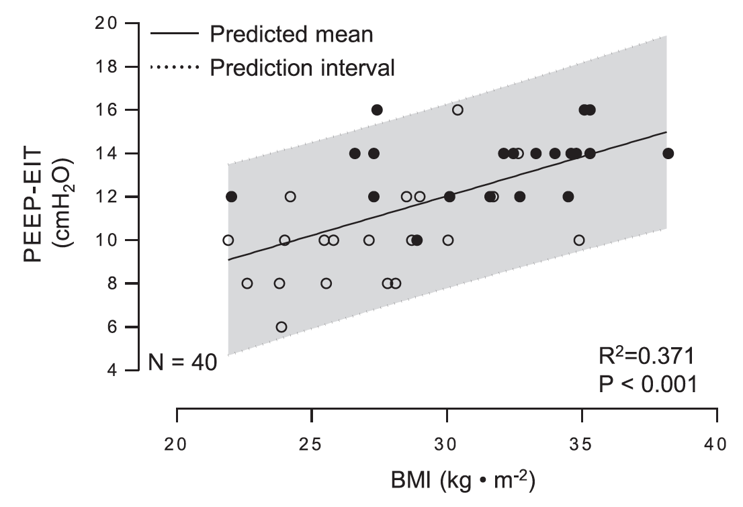
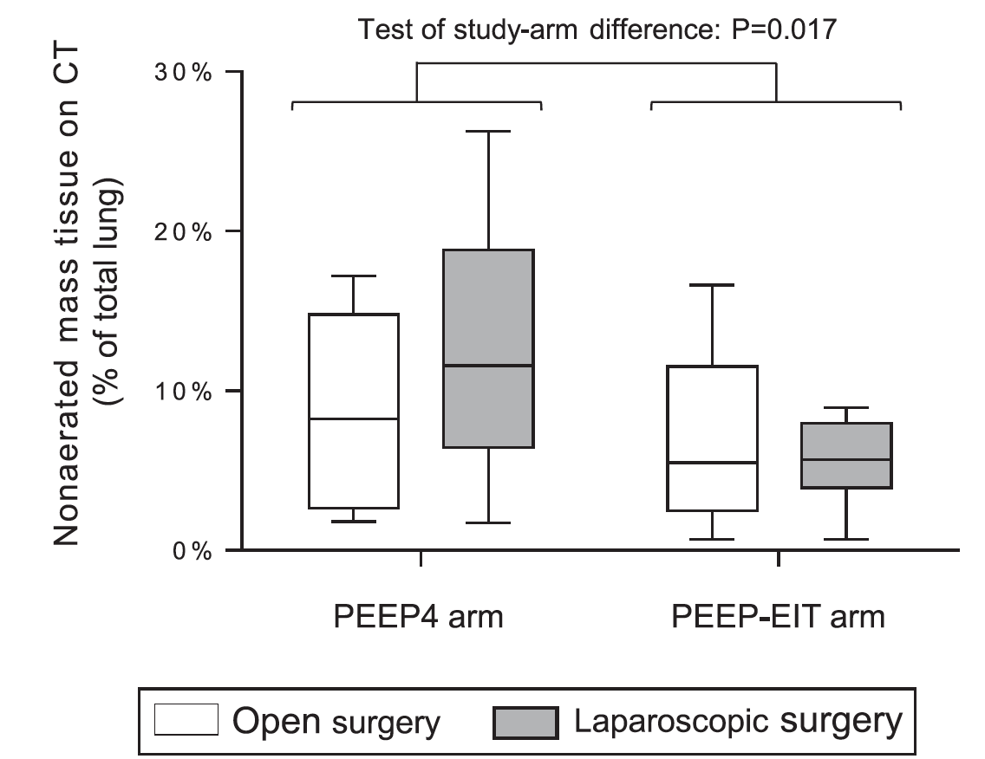
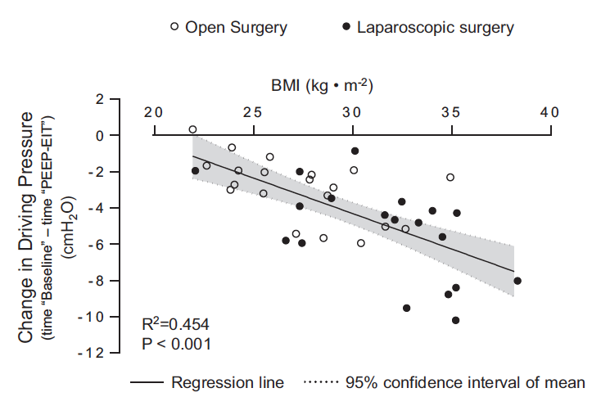
Individualized EIT-guided PEEP does not improve post-operative atelectasis
Pereira SM et al. Anesthesiology. 2018 Dec;129(6):1070-1081
Pelosi P for the PROVE Network (www.provenet.eu)

Slide 37

Effects of intraoperative PEEP
on PPCs in non obese patients
PROVEnet investigators. Lancet. 2014 9;384(9942):495-503
Estimated Effect
1.01 (0.86 – 1.20)
40
P=0.86
In Higher PEEP group:
Better intraop SatO₂
Lower intraop △P
More fluids
More vasoactive drugs
More bradicardia
More pleural effusions
NO DIFFERENCE !
Patients (%)
20
40
39
0
Lower PEEP
w/o RM
N=453
Higher PEEP
+ RM
N=447
Pelosi P for the PROVE Network (www.provenet.eu)

Slide 38
Effects of intraoperative PEEP
on PPCs in obese patients
PROVEnet investigators JAMA. 2019 Jun 18;321(23):2292-2305
Estimated Effect
0.93 (0.83 – 1.04)
30
In Higher PEEP group:
Better intraop SatO₂
Lower intraop △P
More fluids
More vasoactive drugs
More bradicardia
More pleural effusions
Higher post-op mortality
P=0.23
NO DIFFERENCE !
Patients (%)
15
23.6
21.3
0
Lower PEEP
w/o RM
N=987
Higher PEEP
+ RM
N=989
Pelosi P for the PROVE Network (www.provenet.eu)

Slide 39
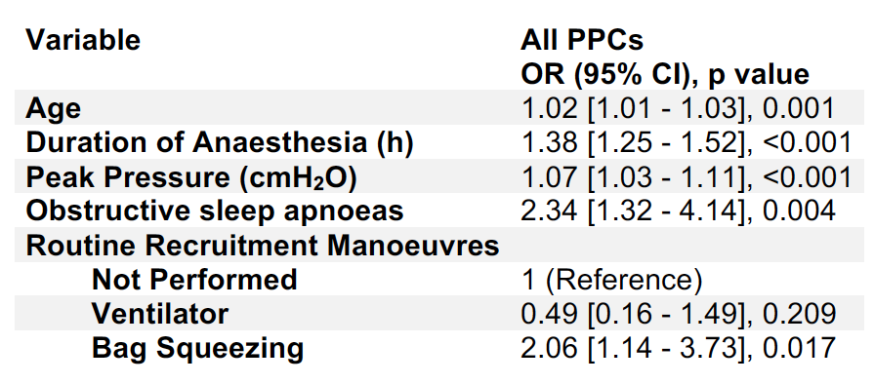
Recruitment by bag squeezing increases
Postoperative pulmonary complications
Ball L et al. Br J Anaesth. 2018 Oct;121(4):899-908
2012 obese patients from 135 hospitals
across 29 countries in Europe, North America, North Africa & Middle East
Pelosi P for the PROVE Network – www.provenet.eu

Slide 40
Higher PEEP promotes increased Lung Injury Biomarkers in the postoperative period
Serpa-Neto A et al. Eur J Anaesthesiol. 2017 Apr;34(4):229-238
High PEEP vs Low PEEP:
INCREASED Lung injury biomarkers
Club cell-specific protein CC-16
)open symbols, green box (low PEEP)
closed symbols, red box (high PEEP
Pelosi P for the PROVE Network (www.provenet.eu)

Slide 41
Higher △P,rs with PEEP is associated with PPCs
Neto AS et al. Lancet Respir Med. 2016 Apr;4(4):272-80.
Ball L et al. Ann Transl Med. 2018 Oct;6(19):379.
ΔP = Pplat,rs – PEEP = V_{T}/Cst = V_{T}/EELV
Pelosi P for the PROVE Network (www.provenet.eu)

Slide 42

The Funeral for Positive End-Expiratory Pressure … better known as PEEP
“It was a dream for generations
of Anesthesiologists and Intensivists”
PEEP
1967
……
Rest
in
peace
Keep it simple:
“the best PEEP is the lowest just enough for the lung
and the heart”
Pelosi P for the PROVE Network – www.provenet.eu

Slide 43
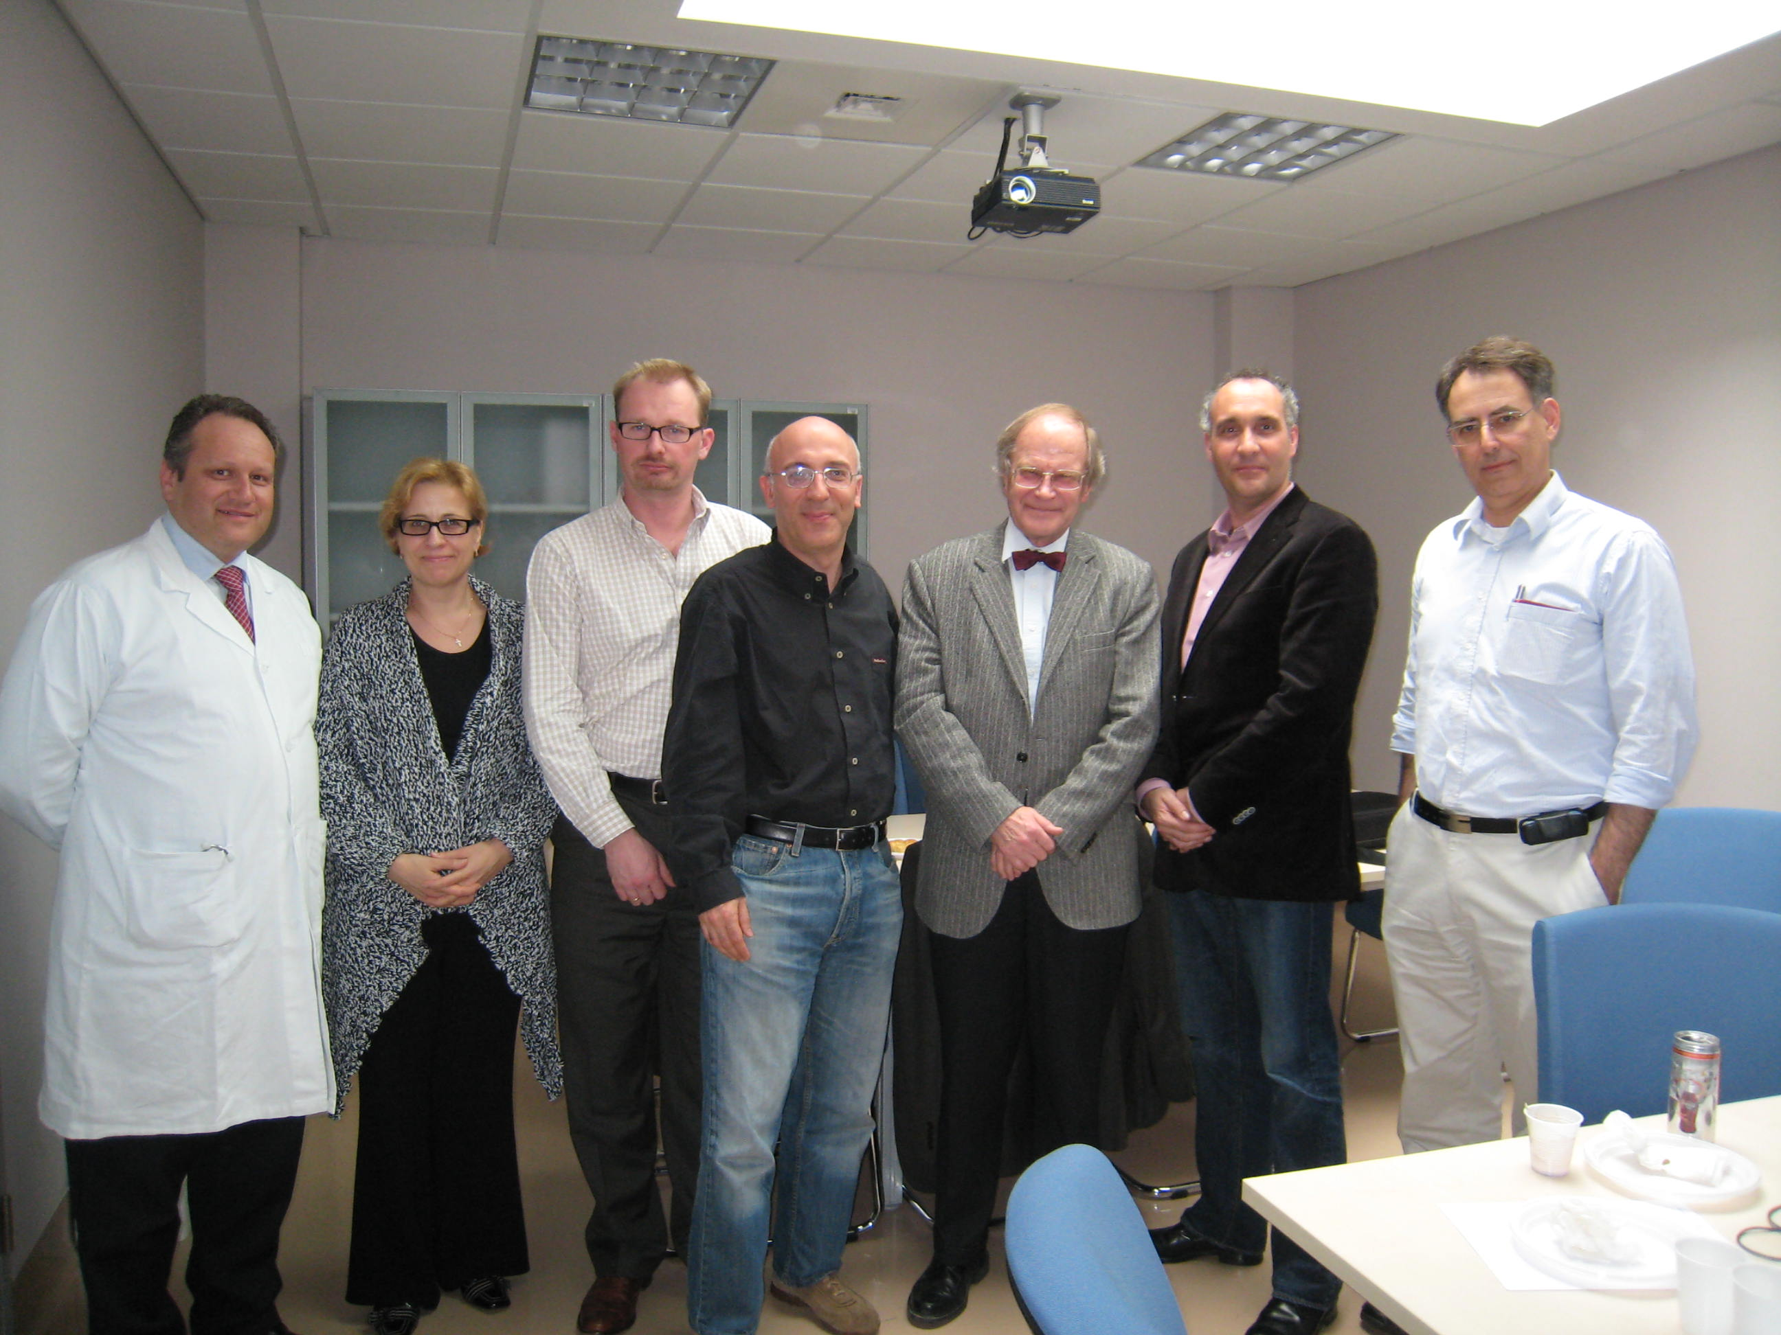
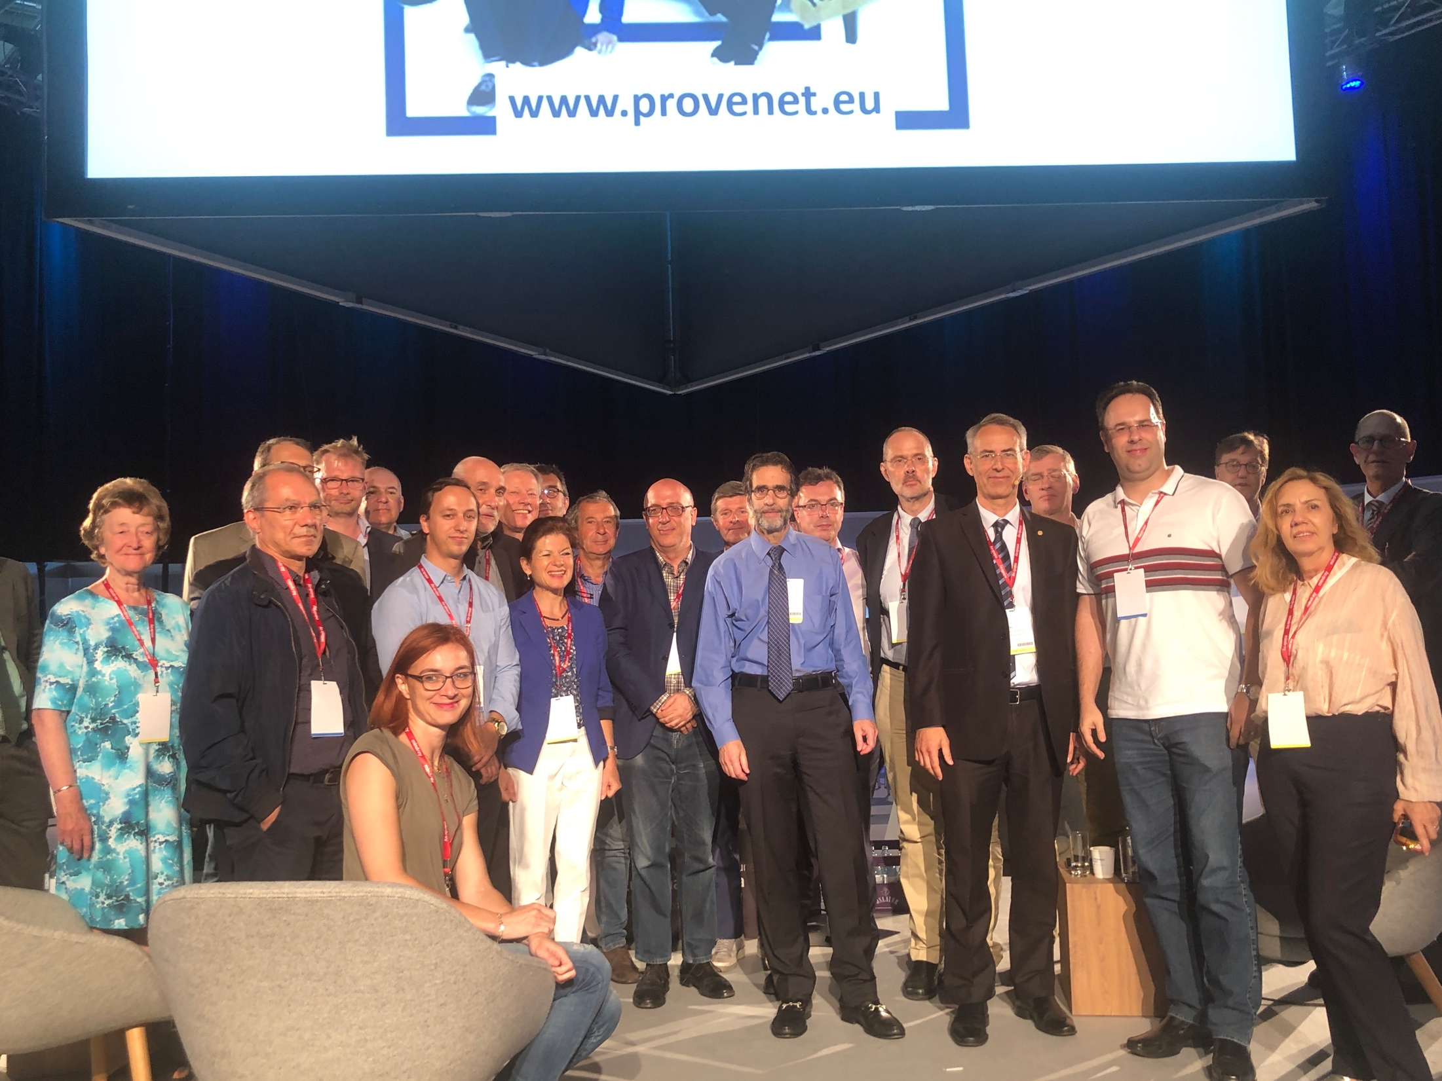
Protective mechanical ventilation during general anesthesia (non-obese and obese patients)
Young CC et al. Br J Anaesth. Br J Anaesth 123 (6), 898-913
PROVHILO Trial - Lancet 2014
PROBESE Trial - JAMA 2019
Low Tidal Volume (7-10 ml/Kg PBW),
Low PEEP (5 cmH2O or less), no RM
Further evaluation:
Laparoscopic surgery
Duration > 3 hours
Trendelenburg position
Pplat < 17 cmH2O (<22 cmH2O in obese)
ΔP< 13 cmH2O (< 18 cmH2O in obese)
If SatO2 < 92% – Increase FiO2 up to 90%
If Sat O2 < 92% persists – RM and Increase PEEP
Pelosi P for the PROVE Network (www.provenet.eu)

Slide 44
Future RCTs on Intraoperative Ventilation
AVATAR study: Ventilatory management
during robotic surgery
Queiroz VNF et al. BMJ Open 2018 Aug 23;8(8):e021643
PROTHOR trial (OLV): high vs. low PEEP, during lower V_{T} ventilation
Avatar investigators. Br J Anaesth. 2020 Oct 31
Kiss T, Senturk M et al. Trials. 2019 Apr 11;20(1):213.
Designation trial: PEEP set according to △P vs lower PEEP
http://www.provenet.eu/
Pelosi P for the PROVE Network – www.provenet.eu

Slide 45
Agenda
Postoperative mortality
Atelectasis in the perioperative period
Postoperative pulmonary complications:
- definition
- incidence
- type of surgery
- timing
- mortality
- obesity
- night time
Predictive scores
Intraoperative complications
Intraoperative PEEP to prevent PPC
Strategies to prevent PPC
Conclusions
Pelosi P for the PROVE Network (www.provenet.eu)

Slide 46
Preoperatively
Strategies to prevent PPCs
Pelosi P et al. Curr Opin Crit Care. 2018 Dec;24(6):581-587
Guldner A., Pelosi P., de Abreu G.M. Curr Opin Anesthesiol 2013, 26:141–151
Assess general physical status and identify risk factors
- Risk Scores
  Preoperative SpO₂
Preoperative “optimization”
  Cessation of smoking
  Treat pre-op infection and/or bronchospasm
  Alleviate anemia (< 10 g/dL) (?)
Education regarding physiotherapy

Slide 47
Intraoperatively
Strategies to prevent PPCs
Strategies to prevent PPCs
Pelosi P et al. Curr Opin Crit Care. 2018 Dec;24(6):581-587
Guldner A., Pelosi P., de Abreu G.M. Curr Opin Anesthesiol 2013, 26:141–151
Anaesthetic/surgical plan
  Consider regional anesthesia for pain control
  Type of anesthesia – opioids sparing/free?
  Choose short-acting drugs/avoid PORC (monitoring)
  Limit duration of surgery and fluids - GDT
  If feasible, use laparoscopic techniques (Robotic?)
  Reduce emergent surgery
Ventilatory strategies
  Protective ventilation (Low tidal volume 6-8 ml/kg IBW)
  No recruitment maneuvres by bag squeezing
  Limit high oxygen concentrations (< 70%)
  Maintain PaCO₂

Slide 48
Postoperatively
Strategies to prevent PPCs
Pelosi P et al. Curr Opin Crit Care. 2018 Dec;24(6):581-587
Guldner A., Pelosi P., de Abreu G.M. Curr Opin Anesthesiol 2013, 26:141–151
Selective use of nasogastric tube
- If PONV
- Inability to oral feeding
- Abdominal distension
Effective pain management and minimize respiratory depression
Post-op Physiotherapy and/or NRS
- Early ambulation
- Mobilization of secretions and Deep breathing (Incentive spirometry?)
- Preventive HFONT/CPAP/NPPV (no clear evidence – selected pts)
Early detection
- N(M)EWS (SatO₂ & RR)

Slide 49
Perioperative lung protection: a simple bundle !
Ball L . et al. Anesth Analg. 2020 Dec;131(6):1789-1798
Pelosi P for the PROVE Network (www.provenet.eu)

Slide 50
How to optimize critical care resources in surgical
patients: intensive care without physical borders
Pelosi P et al. Curr Opin Crit Care. 2018 Dec;24(6):581-587
Patient trajectory

Slide 51
How to optimize critical care resources in critically ill patients: intensive care without physical borders
Pelosi P et al. Curr Opin Crit Care. 2018 Dec;24(6):581-587
Hospital - Intensive Care Unit Interface

Slide 52
Agenda
Postoperative mortality
Atelectasis in the perioperative period
Postoperative pulmonary complications:
- definition
- incidence
- type of surgery
- timing
- mortality
- obesity
- night time
Predictive scores
Intraoperative complications
Intraoperative PEEP to prevent PPC
Strategies to prevent PPC
Conclusions
Pelosi P for the PROVE Network (www.provenet.eu)

Slide 53
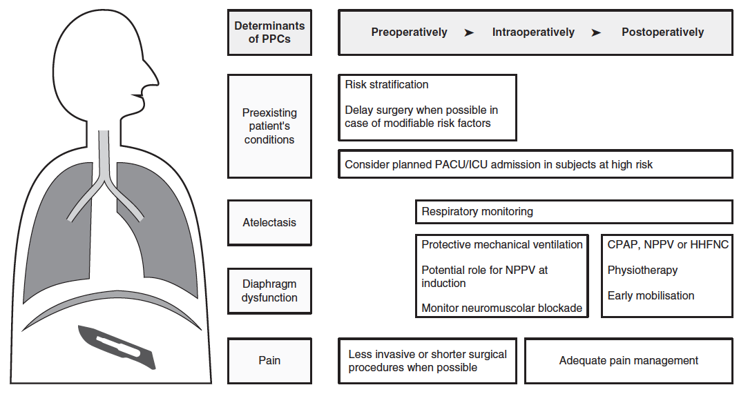
Protective ventilation is just one card of the puzzle
Ball L.et al. Minerva Anestesiol. 2016 Mar;82(3):265-7
Ball L. et al. Curr Opin Crit Care 2016, 22:379–385
Ball L et al. Minerva Anestesiol. 2017 Oct;83(10):1075-1088
Hemodynamic monitoring
Fluids management
Pelosi P for the PROVE Network (www.provenet.eu)

Slide 54
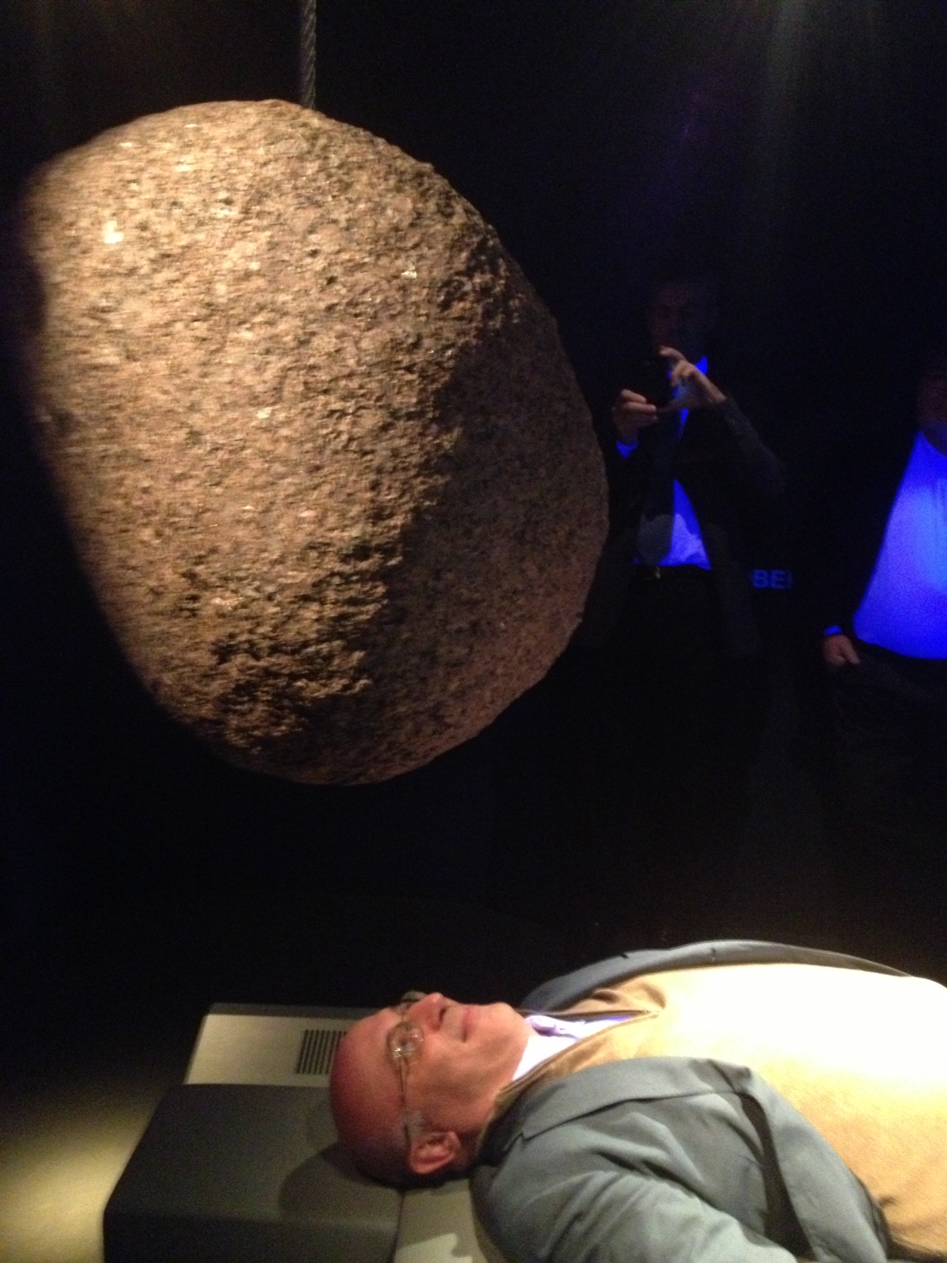
Postoperative Pulmonary Complications
A Reality !

